Slide 1
A Seminar on Face Recognition Attendance system using Python
Team Details:
G. Sanjay Deep (20EG105414)
V. Hemanth (20EG105450)
D. Nithin Reddy (20EG105408)
Project Supervisor
E. Radha Krishnaiah
Assistant Professor

Slide 2
Introduction
This para covers following :
What it is ,What is needed, what are applications,

Slide 3
Introduction
Scope of the project:
We are setting up to design a system comprising of two modules. The first module (face detector) is a mobile component, which is basically a camera application that captures student faces and stores them in a file using computer vision face detection algorithms and face extraction techniques. The second module is a desktop application that does face recognition of the captured images (faces) in the file, marks the students register and then stores the results in a database for future analysis.
Advantages:
Ease in maintaining attendance
Reduced paper work
Automatically operated and accurate
User friendly
Applications:
Automated Time Tracking
Enhances Workplace Security
Contactless Attendance

Slide 4
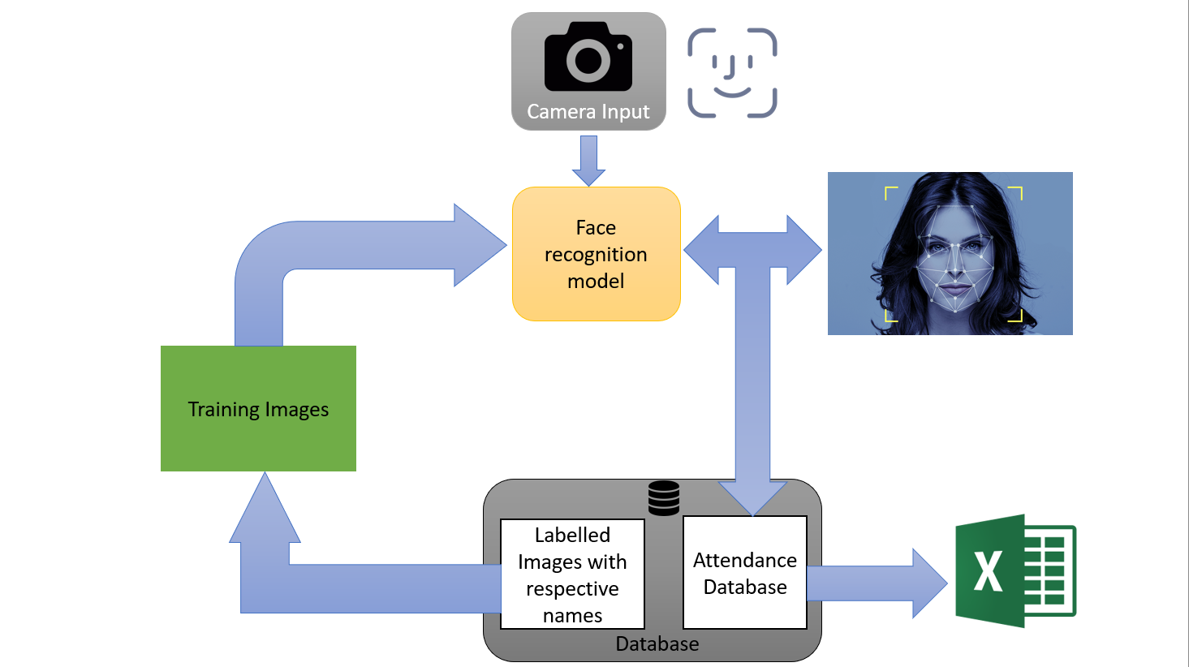
Concept Tree

Slide 5
Literature
Sl.No | Strategies | Advantages | Disadvantages
1 | RFID (Radio Frequency Identification) card system | Simple | Fraudulent usage, Lack of Security.
2 | Fingerprint system | Accurate | Time consuming. Issues with recognition of damaged fingerprints.
3 | Voice recognition system | Less accurate | Less accurate compared with others. Some voices don’t come across well.
4 | Iris recognition system | Accurate | Privacy Invasion, problems in certain environmental conditions like low lighting or extreme sunlight

Slide 6
Literature
Sl.No | Author | Strategies | Advantages | Disadvantages
1 | Hoa Yang and Xiaofeng han | LDA method | 1. High detection Speed. 2. High Accuracy. | 1. Long Training Time. 2.Limited Head Pose. 3.Not able to detect dark faces.
2 | Shivangi Awasthi, Shubhangi Awasthi | Local Binary Pattern Histogram | 1.Simple computation. 2.High tolerance | 1.Only used for binary and grey images. 2.Overall performance is inaccurate compared to Viola-Jones Algorithm.
3 | S.Sveleba , I. Katerynchuk , I Karpa | Ada Boost Algorithm | Need not to have any prior knowledge about face structure. | The result highly depends on the training data and affected by weak classifiers
4 | R.Nandhini, N. Duraimurugan , and S. P.Chokkalingam | SMQT Features and SNOW Classifier Method | 1. Capable to deal with lighting problem in object detection. 2. Efficient in computation. | The region contain very similar to grey value regions will be misidentified as face.
5 | H.K.Nguyen,M.T. Chew | Neural-Network | High accuracy only if large size of image were trained. | 1. Detection process is slow and computation is complex. 2. Overall performance is weaker than Viola-Jones algorithm

Slide 7
Problem Statement
The current face recognition attendance system lacks the capability to simultaneously recognize multiple individuals and capture images during scanning, posing a limitation in accurately recording attendance for groups of people.
Apart from calling names, attendance sheet is passed around the classroom during the lecture sessions. The lecture class especially the class with a large number of students might find it difficult to have the attendance sheet being passed around the class. Thus, face recognition attendance system is proposed in order to replace the manual signing of the presence of students which are burdensome and causes students get distracted in order to sign for their attendance. Furthermore, the face recognition based automated student attendance system able to overcome the problem of fraudulent approach and lecturers does not have to count the number of students several times to ensure the presence of the students.

Slide 8
Problem Illustration
In our effort to make keeping track of attendance easier in schools and workplaces, we want to create a smart Face Recognition Attendance System using Python. But there are some important challenges we need to solve to make sure it works well:
Firstly, we want the system to recognize faces accurately, even in different lighting or when people make different expressions. We need it to avoid making mistakes, like marking someone absent when they're actually there.
Then, we're really serious about protecting people's privacy. The system needs to keep facial data safe by encrypting it and following privacy rules, so no one can access it without permission.
By investigating two colleges A and B in a province, we conducted experiments in colleges based on the application of face recognition attendance system accuracy, and selected 200 college students who need to punch cards. According to the experimental results, the accuracy rate of face recognition in the classroom video of the two colleges is currently high, and the accuracy rate of face recognition in the college video is about 75%. About 30% of the failed card punches due to video blur, it can be seen from these data that the accuracy rate of the video face recognition system is relatively Normal.

Slide 9
Problem Illustration
A- Video face recognition accuracy.
Attendance check | School 1 | School 2
no. of students | 80 | 82
Traditional Roll call | 65 | 70
Face recognition | 30 | 25
B- Statistical table for checking student attendance. (Missing Attendance Table )
Video Face Recognition accuracy | School 1 |  | School 2
 | Test group | Control group | Test group | Control group
Accuracy Identification | 75 | 80 | 68 | 88
Video Blur | 30 | 5 | 20 | 10

Slide 10
Proposed Method
Face Recognition Algorithm
Face recognition is the process of detecting or confirming the identity of individuals based on facial images. It utilizes libraries like OpenCV and Dlib to detect and recognize facial features, process images, and implement machine learning algorithms for identification.
Step 1: Import the OpenCV Package
Step 2: Read the Image
Step 3: Convert the Image to Grayscale
Step 4: Load the Classifier
Step 5: Perform the Face Detection
Step 6: Drawing a Bounding Box
Step 7: Displaying the Image

Slide 11
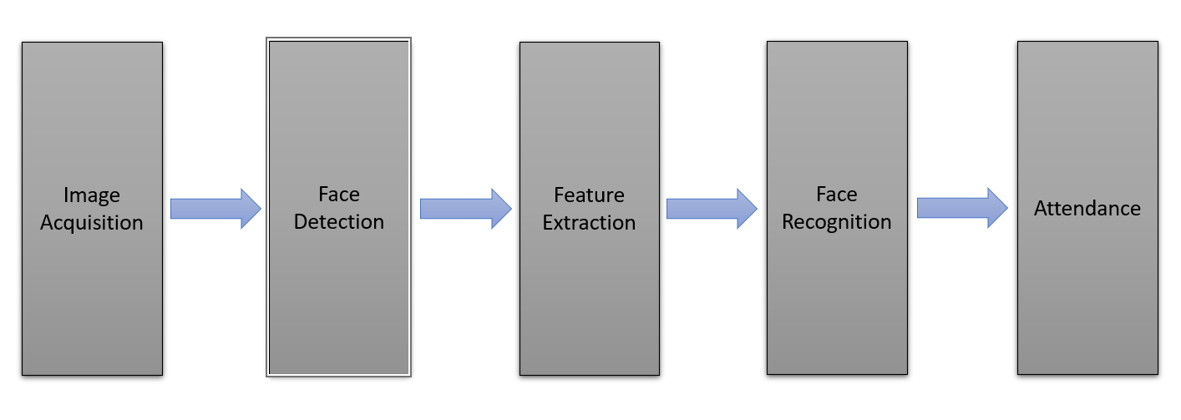
Proposed Method Illustration
Detect human faces in images with OpenCV and Face Recognition in Python
Perform real-time face detection in a live stream from a webcam
Recognize and label student faces in images

Slide 12
Parameter
Accuracy:
The ratio of correctly identified faces to the total number of faces in the dataset. It is commonly expressed as a percentage.
(Total Number of Faces )
Accuracy = ------------------------------------------------------- x 100%
(Number of Correctly Identified Faces)
​
Frame Processing Time (t_frame):
The time taken to process a single frame or image containing faces.
Frames Per Second (FPS):
The number of frames processed in one second. It is the reciprocal of the frame processing time.
FPS = 1 / t_frame

Slide 13
Experiment Environment
Hardware Requirement:
RAM : Minimum 1GB
Hard Disk : 128GB
Processor : Intel Pentium 4 or above
Camera : 4MP or above
Software Requirement:
Operating System : Windows
Coding Language : Python
Platform : PyCharm
Libraries : OpenCV, Face Recognition

Slide 14
Project status
S.No | Functionality | Status
1 | Literature Survey | Completed
2 | Problem Definition | Completed
3 | Module Design | In-Progress
4 | Implementation | In-Progress

Slide 15
References
Shivangi Awasthi, Shubhangi Awasthi - Facial Recognition Attendance System Using Python -2022
HAO YANG1 AND XIAOFENG HAN 2 - Facial Recognition Attendance System Based On Real-Time Video Processing 2020
S.Sveleba , I. Katerynchuk , I Karpa , 1. Kunyo , S. Ugryn , and V.Ugryn . " The real time face recognition . 3rd Int'l Conf . on Advanced Information and Communication Technologies , 2019
R.Nandhini, N. Duraimurugan , and S. P.Chokkalingam, " Face recognition based attendance system . Intl Journal of Engineering and Advanced Technology ( IJEAT ) , Vol - 8 , Issue - 38 . February 2019
H.K.Nguyen,M.T. Chew ,”RFID-based attendance management system”,2017 IEEE.

Slide 16
Thank you

Slide 17
Project seminar–I Evaluation
S.No | Rubrics | Marks
1 | Concept Introduction | 4
2 | Literature and Parameter | 5
3 | Problem and Problem Illustration | 8
4 | Proposed Method and Illustration | 8
Total |  | 25

